Slide 1






Using Bitcoin for Financial Transactions
Risks and Concerns
Josh Hatfield
INFO-I 330 | Section 9663

Slide 2

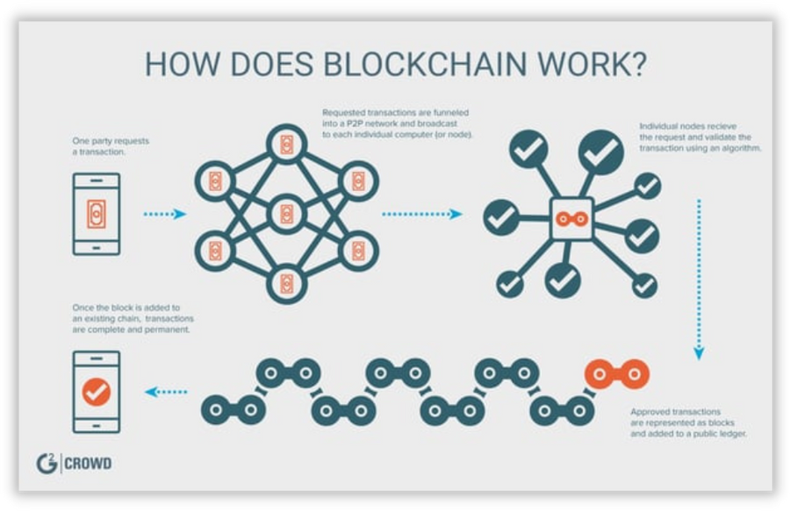


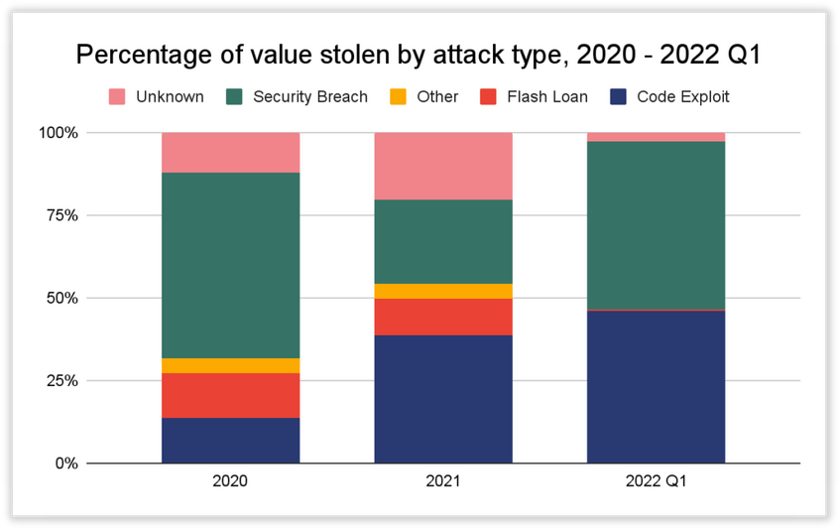
Overview and Security Risks
Due to decentralization, Sybil attacks can lower the 51% hashrate pool for control of a blockchain, thereby blocking transactions or committing double-spending (Sultanik et al., 2022)
Figure 1. How Does Blockchain Work? (n.d.). G2 Crowd. Retrieved November 3, 2022, from https://learn.g2.com/trends/blockchain-security?utm_source=Twitter&amp;utm_medium=Social&amp;utm_campaign=mktg_DT_trends&amp;review_source=mktg.
Oracles relay deterministic functions based on external conditions; can be exploited to bypass slippage checks and alter price calculations (Federal Bureau of Investigation, 2022)
There will always be exploits in the mathematical code making up blockchains such as ECDSA randomness or CVE-2022-21449 (Wang et al., 2020)
Figure 2. Percentage of value stolen by attack type, 2020 - 2022 Q1. (n.d.). Chainalysis. Retrieved November 3, 2022, from https://blog.chainalysis.com/reports/2022-defi-hacks/.

Slide 3

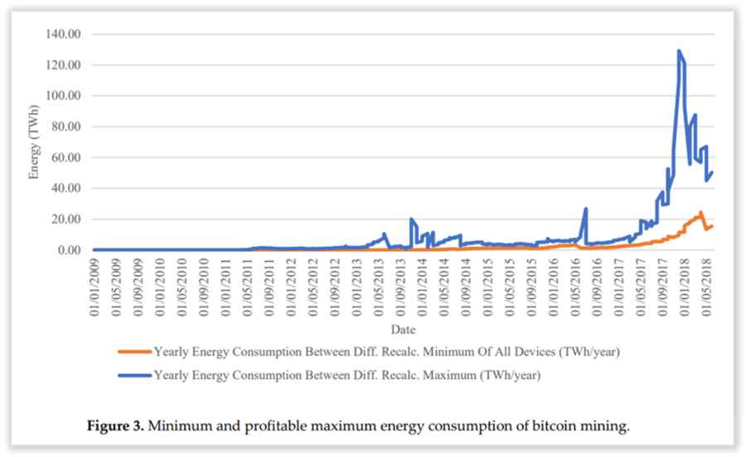
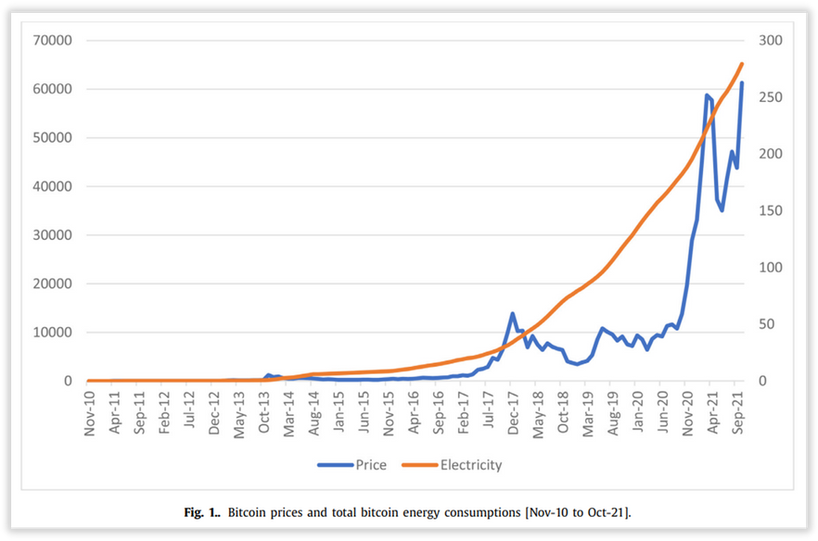

Environmental
Concerns
Bitcoin consumes approximately 0.55% of global electricity production, roughly equivalent to countries like Sweden or Malaysia (Cambridge Center for Alternative Finance, 2021, as cited in Carter, 2021)
Figure 3. Küfeoğlu, S., & Özkuran, M. (2019). Minimum and profitable maximum energy consumption of bitcoin mining. Cambridge Working Papers in Economics. Retrieved November 3, 2022, from https://www.repository.cam.ac.uk/bitstream/handle/1810/294129/cwpe1948.pdf?sequence=1.
China's crackdown has led to more unconventional methods outside of its hydropower plants; natural gas now contributes 31% of electricity mix in China (Hinsdale, 2022)
Although relationally chaotic and nonlinear, there seems to similar trends between prices and electricity consumption (Maiti, 2022)
Figure 4. Maiti, M. (2022). Bitcoin prices and total bitcoin energy consumptions [Nov-10 to Oct-21]. ScienceDirect. Retrieved November 3, 2022, from https://www.sciencedirect.com/science/article/pii/S259005442200015X.

Slide 4
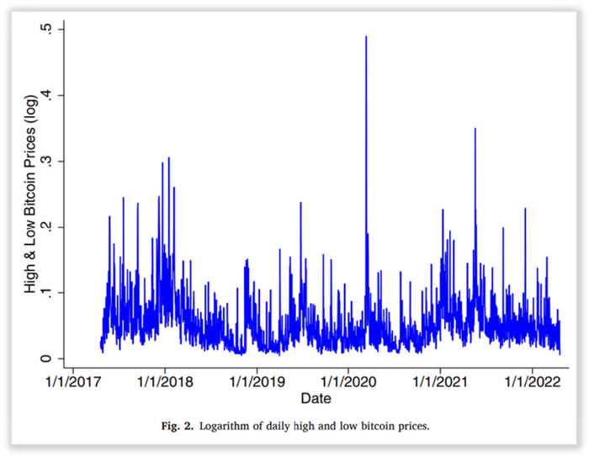
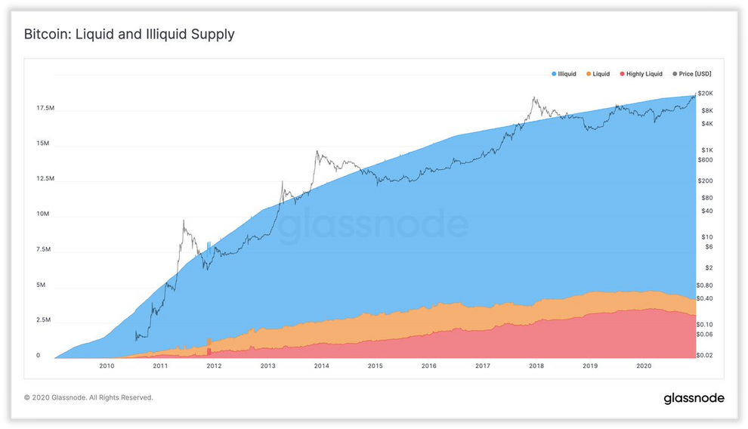
Economic Factors
Intraday volatility is extreme compared to ETF and index funds like the S&P500 (Sarkodie et al., 2022)
Decentralization indicates that entities like banks or governments cannot insure losses from stolen or legitimate transactions
Nearly 80% of all the Bitcoin supply is illiquid; this creates economic buy-side crises (Schultze-Kraft, 2020)
Being dependent on electricity, the value proposition relies on whether the Bitcoin price outweighs the mining costs
Figure 5. Sarkodie, S. A., Ahmed, M. Y., &amp; Leirvik, T. (2022). Logarithm of daily high and low bitcoin prices. ScienceDirect. Retrieved November 3, 2022, from https://www.sciencedirect.com/science/article/pii/S1544612322002264#:~:text=We%20find%20that%20bitcoin%20trade,footprint%20in%20the%20long%20run.&amp;text=A%20dynamic%20shock%20in%20trade,carbon%20footprint%20by%20almost%2050%25.
Figure 6. Heeg, K., &amp; Schultze-Kraft, R. (2020). Bitcoin: Liquid and Illiquid Supply. Glassnode Insights - On-Chain Market Intelligence. Retrieved November 3, 2022, from https://insights.glassnode.com/bitcoin-liquid-supply/.

Slide 5

References
Carter, N. (2021, May 5). How Much Energy Does Bitcoin Actually Consume? Harvard Business Review. Retrieved November 4, 2022, from https://hbr.org/2021/05/how-much-energy-does-bitcoin-actually-consume
Federal Bureau of Investigation. (2022, August). Cyber Criminals Increasingly Exploit Vulnerabilities in Decentralized Finance Platforms to Obtain Cryptocurrency, Causing Investors to Lose Money. (I-082922-PSA). https://www.ic3.gov/Media/Y2022/PSA220829#foot1
Figure 1. How Does Blockchain Work? (n.d.). G2 Crowd. Retrieved November 3, 2022, from https://learn.g2.com/trends/blockchain-security?utm_source=Twitter&utm_medium=Social&utm_campaign=mktg_DT_trends&review_source=mktg.
Figure 2. Percentage of value stolen by attack type, 2020 - 2022 Q1. (n.d.). Chainalysis. Retrieved November 3, 2022, from https://blog.chainalysis.com/reports/2022-defi-hacks/.
Figure 3. Küfeoğlu, S., & Özkuran, M. (2019). Minimum and profitable maximum energy consumption of bitcoin mining. Cambridge Working Papers in Economics. Retrieved November 3, 2022, from https://www.repository.cam.ac.uk/bitstream/handle/1810/294129/cwpe1948.pdf?sequence=1.
Figure 4. Maiti, M. (2022). Bitcoin prices and total bitcoin energy consumptions [Nov-10 to Oct-21]. ScienceDirect. Retrieved November 3, 2022, from https://www.sciencedirect.com/science/article/pii/S259005442200015X.

Slide 6
References (cont.)
Figure 5. Sarkodie, S. A., Ahmed, M. Y., & Leirvik, T. (2022). Logarithm of daily high and low bitcoin prices. ScienceDirect. Retrieved November 3, 2022, from https://www.sciencedirect.com/science/article/pii/S1544612322002264#:~:text=We%20find%20that%20bitcoin%20trade,footprint%20in%20the%20long%20run.&text=A%20dynamic%20shock%20in%20trade,carbon%20footprint%20by%20almost%2050%25.
Figure 6. Heeg, K., & Schultze-Kraft, R. (2020). Bitcoin: Liquid and Illiquid Supply. Glassnode Insights - On-Chain Market Intelligence. Retrieved November 3, 2022, from https://insights.glassnode.com/bitcoin-liquid-supply/.
Hinsdale, J. (2022, May 4). Cryptocurrency's Dirty Secret: Energy Consumption. State of the Planet. Retrieved November 4, 2022, from https://news.climate.columbia.edu/2022/05/04/cryptocurrency-energy/
Maiti, M. (2022). Dynamics of bitcoin prices and energy consumption. Chaos, Solitons & Fractals: X, 9, 1–5. https://doi.org/10.1016/j.csfx.2022.100086
Sarkodie, S. A., Ahmed, M. Y., & Leirvik, T. (2022). Trade volume affects bitcoin energy consumption and carbon footprint. Finance Research Letters, 48, 1–8. https://doi.org/10.1016/j.frl.2022.102977
Sultanik, E., Remie, A., Manzano, F., Brunson, T., Moelius, S., Kilmer, E., Myers, M., Amir, T., & Schriner, S. (2022). [Report HR001120C0084]. Are Blockchains Decentralized? Unintended Centralities in Distributed Ledgers (pp. 1–26). New York, NY: Trail of Bits. Retrieved November 3, 2022, from https://assets-global.website-files.com/5fd11235b3950c2c1a3b6df4/62af6c641a672b3329b9a480_Unintended_Centralities_in_Distributed_Ledgers.pdf.

Slide 7
References (cont.)
Schultze-Kraft, R. (2020, December 29). 78% of the Bitcoin Supply is Not Liquid. Glassnode Insights - On-Chain Market Intelligence. Retrieved November 3, 2022, from https://insights.glassnode.com/bitcoin-liquid-supply/
Wang, Z., Yu, H., Zhang, Z., Piao, J., & Liu, J. (2020). ECDSA weak randomness in Bitcoin. Future Generation Computer Systems, 102, 507–513. https://doi.org/10.1016/j.future.2019.08.034

Slide 8


Questions?

